Slide 1

Artificial Intelligence and Expert Systems
Student Name:-Shardulkumar Patel
Enrollment Number:-12002040701150

Slide 2
Outline:
Introduction
What is an Expert System
Components of Expert System
Advantages and Disadvantages of Expert Systems
Applications of Expert Systems
Scope and Future of Expert Systems
Conclusion

Slide 3
introduction
Artificial intelligence (AI) is the intelligence of machines and the branch of computer science that aims to create it. According to Textbooks, Artificial Intelligence is “the study and design of intelligent agents, where an intelligent agent is a system that perceives its environment and takes actions that maximize its chances of success”.
Artificial intelligence has been the subject of optimism, but has also suffered setbacks and, today has become an essential part of the technology industry, providing the heavy lifting for many of the most difficult problems in computer science. Technologies would not exist today without the sustained federal support of fundamental AI research over the past three decades.
Artificial intelligence (AI) is the field of scientific inquiry concerned with designing mechanical systems that can simulate human mental processes. The field draws upon theoretical constructs from a wide variety of disciplines, including mathematics, psychology, linguistics, neurophysiology, computer science, and electronic engineering.

Slide 4
Major branches of a.i.
Robotics: Mechanical and computer devices that perform tedious tasks with high precision.
Vision system: Capture, store and manipulate the visual images and pictures.
Natural language processing: Computer understands and reacts to the command and statements to natural language like English.
Learning system: Computer changes how it reacts or functions to the feedback provided to it.
Neural system: Computer that can act like or simulate the functioning of the brain.
Expert system: Programming computers to make decisions in real life situations. (ex: expert system help doctors in diagnosing the diseases)

Slide 5
What are expert systems?
Expert systems (ES) are one of the prominent research domains of AI. It is introduced by the researchers at Stanford University, Computer Science Department.
Expert systems are the computer applications developed to solve complex problems in a particular domain, at the level of extra-ordinary human intelligence and expertise.
Expert systems have been built to diagnose disease (Pathfinder is an expert system that assists surgical pathologists with the diagnosis of lymph-node diseases, aid in the design chemical syntheses), the prospect for mineral deposits (PROSPECTOR), translate natural languages, and solve the complex mathematical problem (MACSYMA).
Building an expert system is known as knowledge engineering and its practitioners are called knowledge engineers. The knowledge engineer must make sure that the computer has all the knowledge needed to solve a problem.

Slide 6
Capabilities of an expert system
The Expert Systems are capable of-
They are incapable of-
Advising
Instructing and assisting human in decision making
Demonstrating
Deriving a solution
Diagnosing
Explaining
Interpreting input
Predicting results
Justifying the conclusion
Suggesting alternative options to a problem
Substituting human decision makers
Possessing human capabilities
Producing accurate output for inadequate knowledge base
Refining their own knowledge

Slide 7
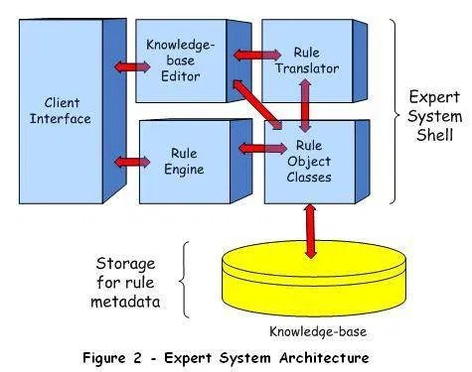
Components of Expert system
An expert system is, typically, composed of two major components, the Knowledge-base, and the Expert System Shell. The Knowledge base is a collection of rules encoded as metadata in a file system, or more often in a relational database. The Expert System Shell is a problem-independent component housing facilities for creating, editing, and executing rules.

Slide 8
Knowledge base
It contains domain-specific and high-quality knowledge. Knowledge is required to exhibit intelligence. The success of any ES majorly depends upon the collection of highly accurate and precise knowledge.
The information is organized as data and facts about the task domain. Data, information, and past experience combined together are termed as knowledge.
The knowledge base of an ES is a store of both, factual and heuristic knowledge.
Factual Knowledge − It is the information widely accepted by the Knowledge Engineers and scholars in the task domain.
Heuristic Knowledge − It is about practice, accurate judgement, one’s ability of evaluation, and guessing.
Knowledge representation is the method used to organize and formalize the knowledge in the knowledge base. It is in the form of IF-THEN-ELSE rules.

Slide 9
Knowledge Acquisition
The success of any expert system majorly depends on the quality, completeness, and accuracy of the information stored in the knowledge base.
The knowledge base is formed by readings from various experts, scholars, and the Knowledge Engineers. The knowledge engineer is a person with the qualities of empathy, quick learning, and case analyzing skills.
He acquires information from subject expert by recording, interviewing, and observing him at work, etc. He then categorizes and organizes the information in a meaningful way, in the form of IF-THEN-ELSE rules, to be used by interference machine. The knowledge engineer also monitors the development of the ES.

Slide 10
Inference engine
Use of efficient procedures and rules by the Inference Engine is essential in deducting a correct, flawless solution.
In case of knowledge-based ES, the Inference Engine acquires and manipulates the knowledge from the knowledge base to arrive at a particular solution.
In case of rule based ES, it −
Applies rules repeatedly to the facts, which are obtained from earlier rule application.
Adds new knowledge into the knowledge base if required.
Resolves rules conflict when multiple rules are applicable to a particular case.
To recommend a solution, the Inference Engine uses the following strategies −
Forward Chaining
Backward Chaining

Slide 11
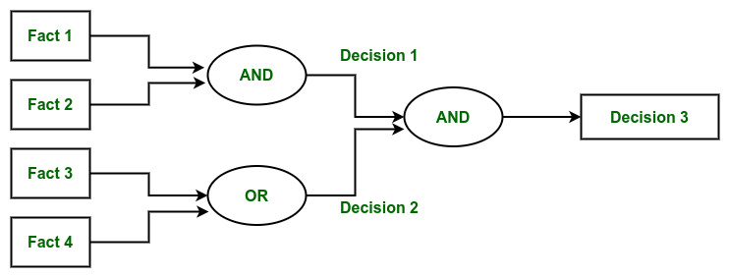
Forward chaining
It is a strategy of an expert system to answer the question, “What can happen next?”
Here, the Inference Engine follows the chain of conditions and derivations and finally deduces the outcome. It considers all the facts and rules, and sorts them before concluding to a solution.
This strategy is followed for working on conclusion, result, or effect. For example, prediction of share market status as an effect of changes in interest rates.

Slide 12
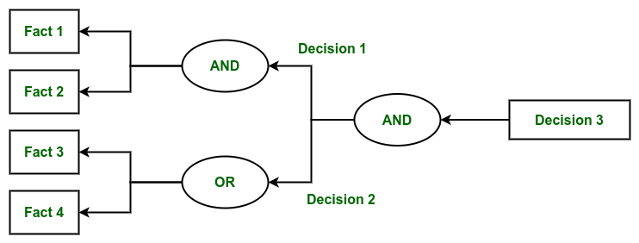
Backward chaining
With this strategy, an expert system finds out the answer to the question, “Why this happened?”
On the basis of what has already happened, the Inference Engine tries to find out which conditions could have happened in the past for this result. This strategy is followed for finding out cause or reason. For example, diagnosis of blood cancer in humans.

Slide 13
Advantages of expert systems
Smarter artificial intelligence may replace human jobs, freeing people for other pursuits by automating manufacturing and transportation.
Self-modifying, self-writing and learning software can relieve programmers of the burdensome tasks of specifying the functions of different programs.
Artificial intelligence will be used as cheap labor, thus increasing profits for the corporation.
Artificial intelligence can make deployment easier and less resource intensive

Slide 14
Disadvantages of expert systems
Rapid advances in AI could lead to massive structural unemployment.
Unpredictable and unforeseen impacts of new features.
An expert system or rule-based approach is not optimal for all problems, and considerable knowledge is required so as to not misapply the systems.
Ease of rule creation and rule modification can be double-edged. A system can be sabotaged by a non-knowledgeable user who can easily add worthless rules or rules that conflict with existing ones. Reasons for the failure of many systems include the absence of (or neglect to employ diligently) facilities for system audit, detection of possible conflict, and rule lifecycle management (e.g. version control, or through testing before deployment). The problems to be addressed here are as much technological as organizational.

Slide 15
applications
Different types of medical diagnosis like internal medicine, blood diseases and show on.
Diagnosis of the complex electronic and electromechanical system.
Diagnosis of a software development project.
Planning experiment in biology, chemistry and molecular genetics.
Forecasting crop damage.
Diagnosis of the diesel-electric locomotive system.
Identification of chemical compound structure.
Scheduling of customer order, computer resources and various manufacturing task.
Assessment of geologic structure from dip meter logs.
Assessment of space structure through satellite and robot.
Teaching students specialize task.
Assessment of log including civil case evaluation, product liability etc.

Slide 16
examples
MYCIN – One of the earliest expert systems based on backward chaining. It can identify various bacteria that can cause severe infections and can also recommend drugs based on the person’s weight.
DENDRAL – It was an artificial intelligence-based expert system used for chemical analysis. It used a substance’s spectrographic data to predict its molecular structure.
R1/XCON – It could select specific software to generate a computer system wished by the user.
PXDES – It could easily determine the type and the degree of lung cancer in a patient based on the data.
CaDet – It is a clinical support system that could identify cancer in its early stages in patients.
DXplain – It was also a clinical support system that could suggest a variety of diseases based on the findings of the doctor.

Slide 17
Scope of expert systems
An expert system is able to do the work of a professional. Moreover, a computer system can be trained quickly, has virtually no operating cost, never forgets what it learns, never calls in sick, retires, or goes on vacation. Beyond those, intelligent computers can consider a large amount of information that may not be considered by humans.
But to what extent should these systems replace human experts? Or, should they at all? For example, some people once considered an intelligent computer as a possible substitute for human control over nuclear weapons, citing that a computer could respond more quickly to a threat. We cannot, however, overlook the benefits of having a computer expert. Forecasting the weather, for example, relies on many variables, and a computer expert can more accurately pool all of its knowledge. Still, a computer cannot rely on the hunches of a human expert, which are sometimes necessary for predicting an outcome.
In conclusion, in some fields such as forecasting the weather or finding bugs in computer software, expert systems are sometimes more accurate than humans. But for other fields, such as medicine, computers aiding doctors will be beneficial, but the human doctor should not be replaced. Expert systems have the power and range to aid to benefit, and in some cases replace humans, and computer experts, if used with discretion, will benefit humankind.

Slide 18
conclusion
It’s now the time to sit and think upon for the future of artificial intelligence in expert systems whether as to go with traditional technologies or to adopt the science of artificial intelligence. The overall motivation behind this presentation is to modernize our ancestral methods so as to bring in a rapid change in the growth of highly developed expert systems so as to cater to the needs of a growing population. The development process may be incremental but the overall concept requires a paradigm shift in the way we think about the modernization of production that is based more on needs and novel ways of meeting them rather than modifying existing techniques. Expert systems have evolved so much that they have started various debates about the fate of humanity in the face of such intelligence, with authors such as Nick Bostrom (Professor of Philosophy at Oxford University), pondering if computing power has transcended our ability to control it.

Slide 19
references
https://krazytech.com/technical-papers/artificial-intelligence
https://www.tutorialspoint.com/artificial_intelligence/artificial_intelligence_expert_systems.htm
https://www.geeksforgeeks.org/expert-systems/?ref=lbp

Slide 20
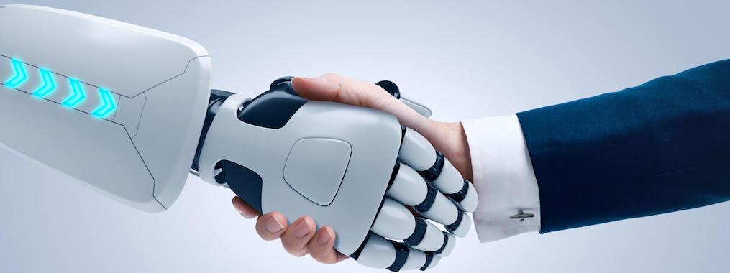
THANK YOU

